Slide 1
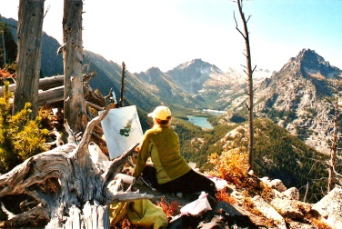
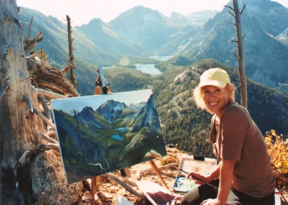
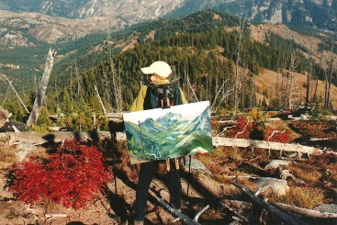
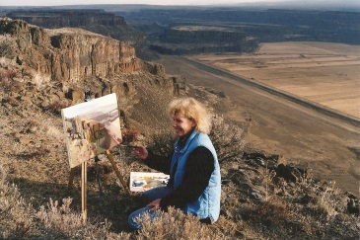
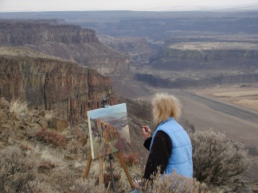
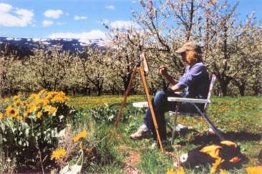
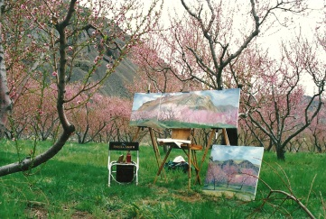
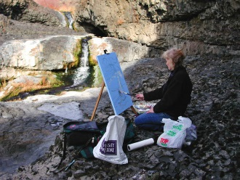
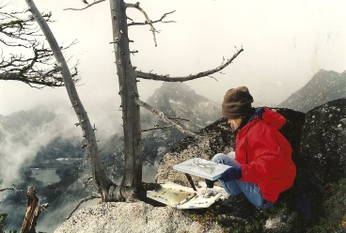
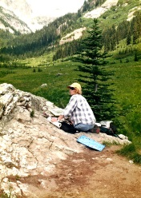
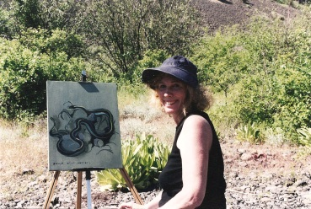
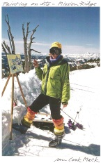
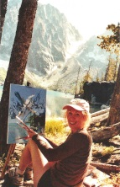
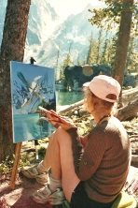
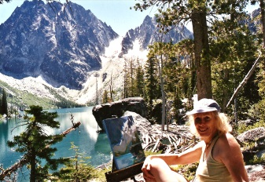
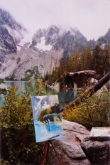
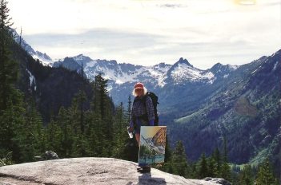
Jan Cook Mack
Painting On Site

Slide 2
Jan Painting Stuart Lake

Slide 3
Mt. Stuart

Slide 4
Jan Painting Snow Lakes

Slide 5
Jan Painting Snow Lake

Slide 6
Jan Packing Out From Wedge Mountain

Slide 7
Wedge Mountain

Slide 8
Jan Painting In Moses Coulee

Slide 9
Jan Painting In Moses Coulee

Slide 10
McCartney Creek From Cliff

Slide 11
Jan Painting Stemilt Cherries

Slide 12
Stemilt Cherry Blossoms

Slide 13
Jan Painting On Site In Apricots

Slide 14
Peach Blossom Orchard In Palisades

Slide 15
Jan Painting At McCartney Creek

Slide 16
Spirit Wing Basalt McCartney Creek

Slide 17
Jan Painting Snow & Nada Lakes

Slide 18
Jan Painting At Spider Meadows

Slide 19
Spider Meadows

Slide 20
Jan Painting A Snake

Slide 21
Accept What Occurs - Snake At Deep Lake

Slide 22
Jan Painting On Site At Mission Ridge

Slide 23
Mt. Stuart From Top Of Mission Ridge

Slide 24
Jan Painting On Site At Colchuck

Slide 25
Jan Painting On Site At Lake Colchuck

Slide 26
Lake Colchuck With Linda

Slide 27
Jan Painting At Lake Colchuck

Slide 28
Necklace Of Boulders From Colchuck On Site

Slide 29
Lake Colchuck Starting To Snow

Slide 30
Lake Colchuck Starting To Snow

Slide 31
Jan Packing Out From Lake Colchuck

Slide 32
Lake Colchuck On Site

